Slide 1
SLO Wayfinding

Slide 2
Team members
Castiel Li
Project Manager
Database Admin
Nate Chiang
Graphic Design
Front-end Dev
Quincy Lam
Full-stack Dev
QA Testing
Ron Tran
Full-stack Dev
QA Testing

Slide 3
Our Client
Student Life Office at BCIT
The Student Life Office is working to enhance the student experience at BCIT by welcoming and connecting students to the range of services and supports available
Hosts events like Kick Start and Program Orientation

Slide 4
Project Description
A web application
Presents all BCIT Student Services
Easy and quick to access
Cover all types of students (Full-time, Part-time, online)
Cover all the campus
Responsive UI

Slide 5
Target Users
All BCIT students
Part-time
Full-time
Online
Burnaby Campus
Downtown Campus
Aeroplane Campus
Everyone!!!

Slide 6
Current System
BCIT Welcome page (https://www.bcit.ca/welcome/)
A lot of details
Many sub pages
Way finding Guide (https://www.bcit.ca/files/lifeatbcit/pdf/student-services-wayfinding-guide-2017.pdf)
Very brief description of each services
No enough information for student to access

Slide 7
Disadvantage with Current System
Too much sub sessions
Difficult to find the perfect service student needed

Slide 8
Purposed Solution (Alternative)
A blog page allows students to post question they wanted to answer by other students
Doesn’t have the information we need to deliver
Too much maintenance required in future
Create a student guiding tour of the services
No easy enough to let student use it right the way
Has Learning curve
Create a virtual map of BCIT Burnaby Campus
Forces on Burnaby Campus too much
Services are offered in other campus as well

Slide 9
Purposed Solution (Final)
A simple web application display all the services with just enough detail for student to get started.
Divide services into eight category to have clean UI
Give student a shortcut/gateway
Use icons and colorful graphic to catch student’s tention

Slide 10


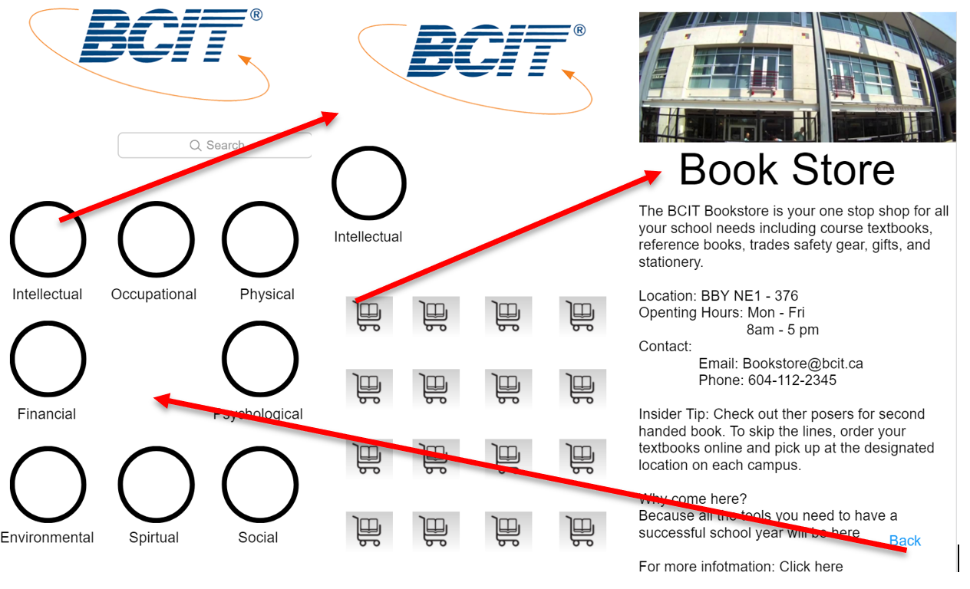



First Wireframe (Mobile)

Slide 11
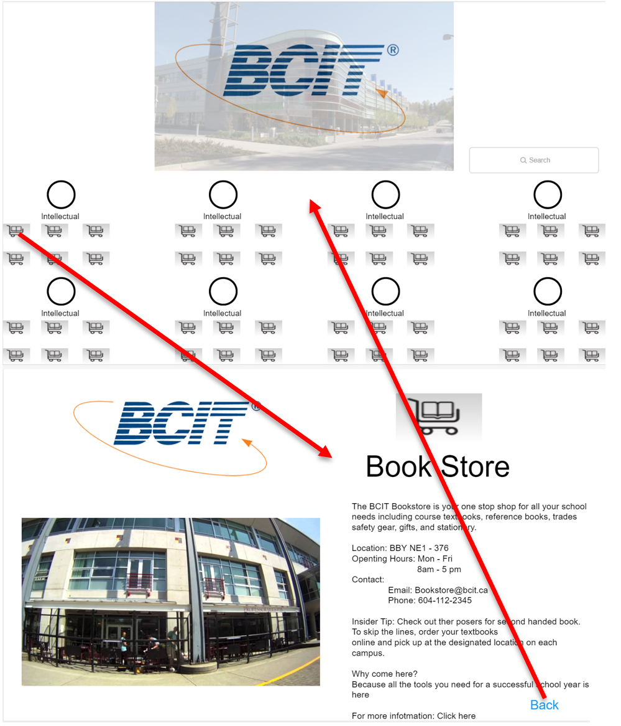
First Wireframe (Desktop)

Slide 12
Technology
React.js
Firebase
Database
Storage
Deploy
Proto.io
Bootstrap
CSS

Slide 13
Deliverables
Idea of functionality
UI/UX design
Responsiveness on mobile and desktop
Easy method to update services in future
Instruction manual of how to update services

Slide 14
Problems
Need to come up with the ideas
Doesn’t have experiences in UI/UX, Graphic design
Unfamiliar with technology used
Database
Need a database to store the video
No video -> no using database
Easy to update -> Use database

Slide 15
How we OVER COME those problem?
Look at other colleges and see what kind functionality they using
Check some well made website for UI/UX design
Make the whole project very flexible in order to make change easily
Learn technologies with example, build small things

